Slide 1
Introduction to Graphs
What is a Graph?
Some Example applications of Graphs.
Graph Terminologies.
Representation of Graphs.
  Adjacency Matrix.
  Adjacency Lists.
  Simple Lists
Review Questions.

Slide 2
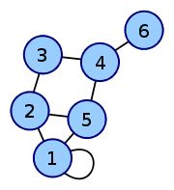
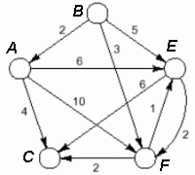
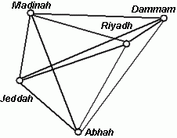
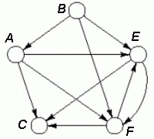
What is a Graph?
Graphs are Generalization of Trees.
A simple graph G = (V, E) consists of a non-empty set V, whose members are called the vertices of G, and a set E of pairs of distinct vertices from V, called the edges of G.
  A simple graph has no loop (An edge that connects a vertex to itself)
  A simple graph has no vertices joined by multiple edges
Example: A graph with a loop:
Undirected
Directed (Digraph)
Weighted

Slide 3
Some Example Applications of Graphs
Finding the least congested route between two phones, given connections between switching stations.
Determining if there is a way to get from one page to another, just by following links.
Finding the shortest path from one city to another.
As a traveling sales-person, finding the cheapest path that passes through all the cities that the sales person must visit.
Determining an ordering of courses so that prerequisite courses are always taken first.
Networks:Vertices represent computers and edges represent network
connectionsbetween them.
World Wide Web: Vertices represent webpages, and edges represent hyperlinks.

Slide 4





Graphs Terminologies
Adjacent Vertex: A vertex W is adjacent to a vertex V if there is an edge from V to W
  Example:
  B is adjacent to A; but A is not adjacent to B
A path: A path is a sequence of consecutive edges in a graph. The length of the path is the number of edges traversed.
A cycle (or circuit): a subset of the edge set that forms a path such that the first vertex of the path is also the last.
A graph containing no cycles of any length is known as an acyclic graph, whereas a graph containing at least one cycle is called cyclic graph.
Connected graph: A graph is connected if there is a path from any vertex to every other vertex. Alternatively a graph is connected if there is a path connecting every pair of vertices.
An undirected graph that is not connected can be divided into connected components (maximal disjoint connected subgraphs). For example, the disconnected graph below is made of two connected components.
Path
Cycle
Connected
Disconnected

Slide 5
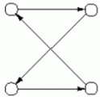
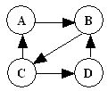
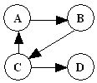
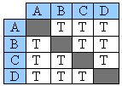
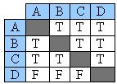
More Graph Terminologies
Path and cycles in a digraph: must move in the direction specified by the arrows.
Connectedness in a digraph: strong and weak.
Strongly Connected: If connected as a digraph [There is a path from each vertex to every other vertex]
Weakly connected: If the underlying undirected graph is connected [There is at least one vertex that does not have a path to every other vertex]
Directed Cycle
Strongly Connected
Weakly Connected

Slide 6

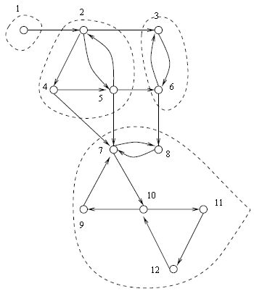
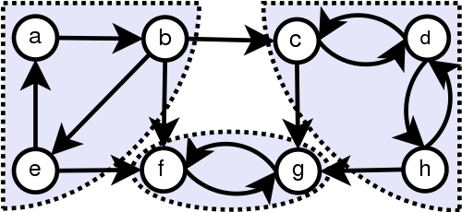
Strongly Connected Components (SCCs)
A disconnected or weakly connected directed graph can be divided into two or more strongly connected components. Two vertices of a directed graph are in the same strongly connected component if and only if they are reachable from each other.
A strongly connected component in a directed graph G = (V, E) is a maximal set of vertices such that for every pair of vertices u and v in the component, vertices u and v are reachable from each other.
Note: If a graph is strongly connected it has only one strongly connected component.
Examples:
Graph2:
Graph1:
Graph1 has two strongly connected components
Graph3:
Graph2 has four strongly connected components
Graph3 has three strongly connected components

Slide 7
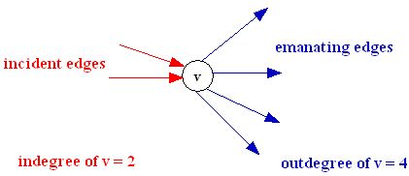
Further Graph Terminologies
Emanating edge: an edge e = (v, w) is said to emanate from v.
  A(v) denotes the set of all edges emanating from v.
Incident edge: an edge e = (v, w) is said to be incident to w.
  I(w) denote the set of all edges incident to w.
Out-degree: number of edges emanating from v: |A(v)|
In-degree: number of edges incident to w: |I(w)|

Slide 8
Further Graph Terminologies
Subgraph: A graph G = (V_{G} , E_{G} ) is a subgraph of H = (V_{H}, E_{H}) if
V_{G} ⊆ V_{H} and E_{G} ⊆ E_{H}.
A spanning subgraph of G is a subgraph that contains all the vertices of G
A spanning tree of a connected graph is a spanning subgraph that is a tree

Slide 9
Graph Representations
For vertices:
  an array or a linked list can be used
For edges:
  Adjacency Matrix (Two-dimensional array)
  Adjacency List (One-dimensional array of linked lists)
  Linked List (one list only)

Slide 10
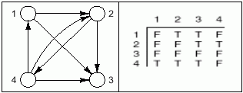
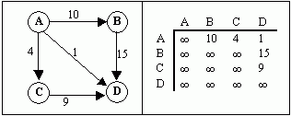
Adjacency Matrix Representation
Adjacency Matrix uses a 2-D array of dimension |V|x|V| for edges. (For vertices, a 1-D array is used)
The presence or absence of an edge, (v, w) is indicated by the entry in row v, column w of the matrix.
For an unweighted graph, boolean values could be used.
For a weighted graph, the actual weights are used.

Slide 11
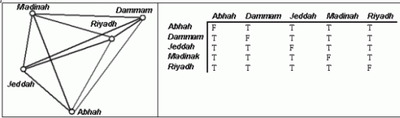
Notes on Adjacency Matrix
For undirected graph, the adjacency matrix is always symmetric.
In a Simple Graph, all diagonal elements are zero (i.e. no edge from a vertex to itself).
The space requirement of adjacency matrix is O(n²) - most of it wasted for a graph with few edges.
However, entries in the matrix can be accessed directly.

Slide 12
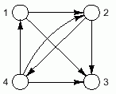
Adjacency List Representation
This involves representing the set of vertices adjacent to each vertex as a list. Thus, generating a set of lists.
This can be implemented in different ways.
Our representation:
  Vertices as a one dimensional array
  Edges as an array of linked list (the emanating edges of vertex 1 will be in the list of the first element, and so on, …
vertices
edges
1
2
3
4
•
•
•
•
1,2 | •
1,3 | •
Null
2,3 | •
2,4 | •
Null
Empty
4,1 | •
4,2 | •
4,3 | •
Null

Slide 13
Simple List Representation
Vertices are represented as a 1-D array or a linked list
Edges are represented as one linked list
  Each edge contains the information about its two vertices
vertices
edges
1
2
3
4
edge(1,2)
edge(1,3)
edge(2,3)
edge(2,4)
edge(4,1)
edge(4,2)
edge(4,3)
.
.
.
.
.
.

Slide 14
Comparison between Adjacency Lists and Adjacency Matrices
For a Graph G(V, E), let |V| = n and |E| = m
– Is there an edge from x to y?
  • Matrix: O(1) check value at (x, y)
  • List: O(n) index to x, traverse list to y or end
– Edge insertion or deletion
  Matrix: O(1)
  List: O(n)
- Get successor vertices of a vertex.
  • Matrix: O(n) scan a row
  • List: O(n) traverse a linked list
– Get predecessor vertices of a vertex.
  • Matrix: O(n) scan a column
  • List: O(n + m) traverse all linked lists, which could be as bad as
  O(n+n²) = O(n²).
Visit all edges
  Matrix: O(n²)
  List: O(n + m)
Space
  Matrix: O(n²)
  List: O(n + m)

Slide 15
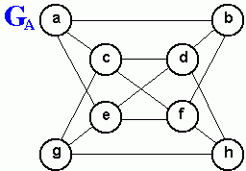
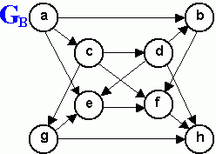
Review Questions
Consider the undirected graph GA shown above. List the elements of V and E. Then, for each vertex v in V, do the following:
  Compute the in-degree of v
  Compute the out-degree of v
  List the elements of A(v)
  List the elements of I(v).
Consider the undirected graph G_{A} shown above.
  Show how the graph is represented using adjacency matrix.
  Show how the graph is represented using adjacency lists.
Repeat Exercises 1 and 2 for the directed graph G_{B} shown above.

